Slide 1

Working with Compute

Slide 2
Eng Teong Cheah
Microsoft MVP

Slide 3



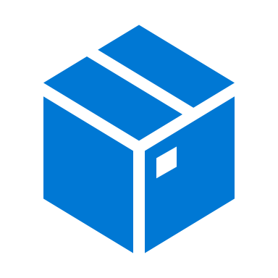

Working with Compute
Environment
Environment
Container
Compute Target

Slide 4
Compute Options for Experiment Runs
Local Compute
- Compute where the control code for the experiment is running
- Often a development workstation or Azure Machine Learning compute instance
Compute Cluster
- Cloud-based cluster managed in an Azure Machine Learning workspace
- Starts, stops, and scales on-demand
Attach Compute - Azure compute resource outside of a workspace
- For example:
Virtual Machine
Azure Databricks
Azure HDInsight

Slide 5
Demo Work with Compute

Slide 6
References
Microsoft Docs

